Slide 1
Chapter 7
Assembly Language

Slide 2
Human-Readable Machine Language
Computers like ones and zeros…
Humans like symbols…
Assembler is a program that turns symbols into
machine instructions.
  ISA-specific:
  close correspondence between symbols and instruction set
    mnemonics for opcodes
    labels for memory locations
  additional operations for allocating storage and initializing data
0001110010000110
ADD R6,R2,R6 ; increment index reg.

Slide 3
An Assembly Language Program
;
; Program to multiply a number by the constant 6
;
.ORIG x3050
LD R1, SIX
LD R2, NUMBER
AND R3, R3, #0 ; Clear R3. It will
; contain the product.
; The inner loop
;
AGAIN ADD R3, R3, R2
ADD R1, R1, #-1 ; R1 keeps track of
BRp AGAIN ; the iteration.
;
HALT
;
NUMBER .BLKW 1
SIX .FILL x0006
;
.END

Slide 4
LC-3 Assembly Language Syntax
Each line of a program is one of the following:
  an instruction
  an assember directive (or pseudo-op)
  a comment
Whitespace (between symbols) and case are ignored.
Comments (beginning with “;”) are also ignored.
An instruction has the following format:
LABEL OPCODE OPERANDS ; COMMENTS
optional
mandatory

Slide 5
Opcodes and Operands
Opcodes
  reserved symbols that correspond to LC-3 instructions
  listed in Appendix A
    ex: ADD, AND, LD, LDR, …
Operands
  registers -- specified by Rn, where n is the register number
  numbers -- indicated by # (decimal) or x (hex)
  label -- symbolic name of memory location
  separated by comma
  number, order, and type correspond to instruction format
    ex:
    ADD R1,R1,R3
    ADD R1,R1,#3
    LD R6,NUMBER
    BRz LOOP

Slide 6
Labels and Comments
Label
  placed at the beginning of the line
  assigns a symbolic name to the address corresponding to line
    ex:
    LOOP ADD R1,R1,#-1
    BRp LOOP
Comment
  anything after a semicolon is a comment
  ignored by assembler
  used by humans to document/understand programs
  tips for useful comments:
    avoid restating the obvious, as “decrement R1”
    provide additional insight, as in “accumulate product in R6”
    use comments to separate pieces of program

Slide 7
Assembler Directives
Pseudo-operations
  do not refer to operations executed by program
  used by assembler
  look like instruction, but “opcode” starts with dot
Opcode
Operand
Meaning
.ORIG
address
starting address of program
.END
end of program
.BLKW
n
allocate n words of storage
.FILL
n
allocate one word, initialize with value n
.STRINGZ
n-character
string
allocate n+1 locations,
initialize w/characters and null terminator

Slide 8
Trap Codes
LC-3 assembler provides “pseudo-instructions” for
each trap code, so you don’t have to remember them.
Code
Equivalent
Description
HALT
TRAP x25
Halt execution and print message to console.
IN
TRAP x23
Print prompt on console,
read (and echo) one character from keybd.
Character stored in R0[7:0].
OUT
TRAP x21
Write one character (in R0[7:0]) to console.
GETC
TRAP x20
Read one character from keyboard.
Character stored in R0[7:0].
PUTS
TRAP x22
Write null-terminated string to console.
Address of string is in R0.

Slide 9
Style Guidelines
Use the following style guidelines to improve
the readability and understandability of your programs:
  Provide a program header, with author’s name, date, etc.,
  and purpose of program.
  Start labels, opcode, operands, and comments in same column
  for each line. (Unless entire line is a comment.)
  Use comments to explain what each register does.
  Give explanatory comment for most instructions.
  Use meaningful symbolic names.
    Mixed upper and lower case for readability.
    ASCIItoBinary, InputRoutine, SaveR1
  Provide comments between program sections.
  Each line must fit on the page -- no wraparound or truncations.
    Long statements split in aesthetically pleasing manner.

Slide 10
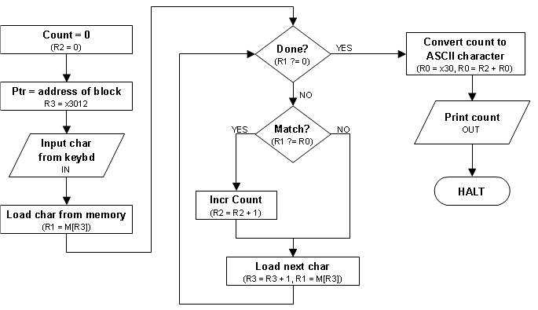
Sample Program
Count the occurrences of a character in a block of memory.

Slide 11
countChar.asm
Try your hand at writing this code in assembly language, using the flowchart as a guide.
You might want to start by writing pseudo-code. Then turn the pseudo-code into comments. Then write the code for each comment.

Slide 12
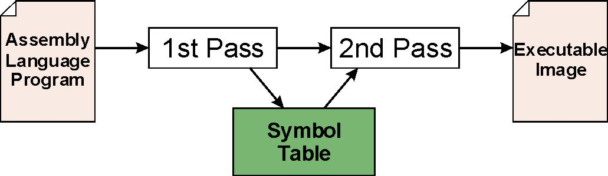
Assembly Process
Convert assembly language file (.asm)
into an executable file (.obj) for the LC-3 simulator.
First Pass:
  scan program file
  find all labels and calculate the corresponding addresses;
  this is called the symbol table
Second Pass:
  convert instructions to machine language,
  using information from symbol table

Slide 13
First Pass: Constructing the Symbol Table
Find the .ORIG statement,
which tells us the address of the first instruction.
  Initialize location counter (LC), which keeps track of the
  current instruction.
For each non-empty line in the program:
  If line contains a label, add label and LC to symbol table.
  Increment LC.
    NOTE: If statement is .BLKW or .STRINGZ,
    increment LC by the number of words allocated.
Stop when .END statement is reached.
NOTE: A line that contains only a comment is considered an empty line.

Slide 14
Practice
Construct the symbol table for countChar.asm.
Symbol
Address

Slide 15
Second Pass: Generating Machine Language
For each executable assembly language statement,
generate the corresponding machine language instruction.
  If operand is a label, substitute the address from the symbol table.
  Check for syntax errors
  Produce final machine instruction

